Slide 1
One Stop Pizza Shop
Double Dough

Slide 2
Problem
Static website with no online ordering functionality

Slide 3
Solution
Create dynamic website with online ordering functionality

Slide 4
Deliverables
EWBAT:
Add/delete menu items
View Active/archived orders based on user
CWBAT:
Create profiles that will remember orders, their contact/payment/delivery info
Log in to the website with this profile to allow for online ordering
Order online with the same ease as ordering over the phone with the benefit of being able to see the items they are purchasing
View and re-order past orders
Pay via Stripe
View Restaurant info via the website

Slide 5
Stakeholders
David: Developer
Responsibilities include:
Doing everything Kyle says
Looking confused 70% of the time
Grunt work (see bullet 1)
Kyle: PM
Responsibilities include:
Scheduling and conducting meetings
Teaching David how to do literally everything
Creating UI and developing the “big idea”

Slide 6
UI Description
So far it looks pretty bad so here is a really nice description:
Menu bar on the top with logo on left, links in the middle for site navigation (Menu, Contact Us, About Us) and sign-in/up on right
Carousel underneath with pics of favorite scrolling by
Basic Sign in Screen (Username and password field) submit button
Logged in screen with past orders occupying previous carousel area
Menu will be in blocks. Each block is a menu item and is clickable. Clicking will redirect to larger image with description and price underneath (Jumbotron with description)
If Employee : Active Orders will be displayed in serial fashion

Slide 7
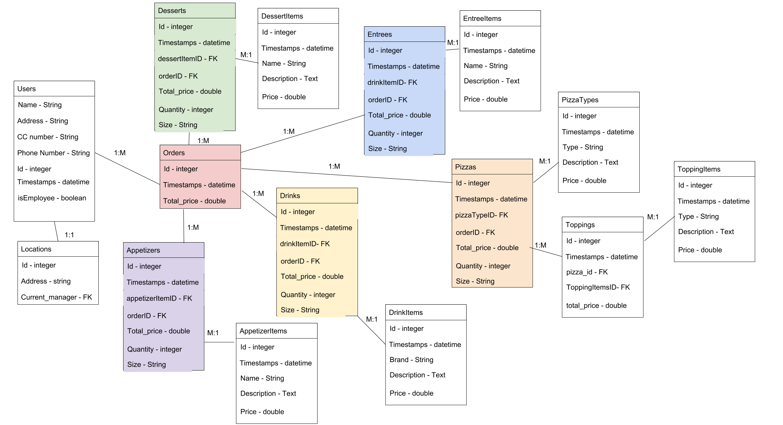


Slide 8
